Slide 1


EnVisionAI
Empowering Sightless Vision with Artificial Intelligence Brilliance
Team: CODE VISION

Slide 2
Introduction
We present you Envision AI for blind people , a groundbreaking journey into the world of AI especially designed to empower and enrich the lives of those with visual impairments.

Slide 3
EnVisionAi
ARTIFICIAL INTELLIGENCE SPECTACULAR GLASS
Its our innovative idea to aid the blind people using AI technology so they can identify people , sense emotions , scan and perceive objects and obstacles clearly.
The major problem faced by blind people is the inability to move without support and unable to identify people, objects , their emotions , etc.
Most of them are helpless because of their disability. So with Envision AI , they can identify through the signals given to their brain and do the needful themselves without external help.

Slide 4
People who are affected by the problem are the visually-disabled people.
They are unable to see things so it is impossible to move around without help.
The sound signals , even though they can be identified , are not fully understood.
With the help of AI , information gathering and processing is increased , giving them the much required help enabling
The development of advanced computer vision systems coupled with wearable devices can empower blind by providing real-time information about their surroundings and enhancing their ability to navigate and interact with the world.

Slide 5
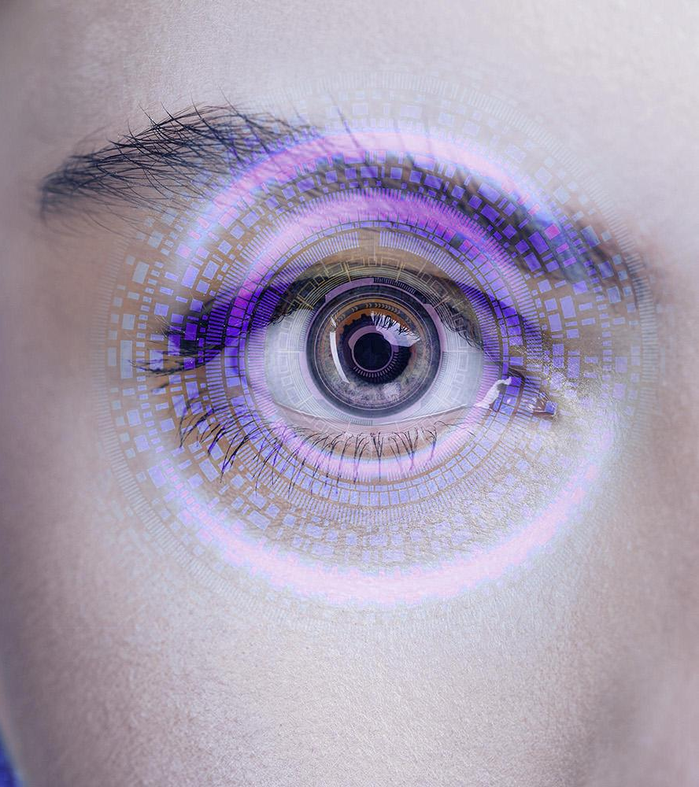
About EnVision AI

Slide 6
Features of EnVision AI
AI-powered Wearable Device
Object Recognition-computer vision algorithms to analyze the captured images and recognize objects, people, and other relevant features.
Auditory Feedback
Optical Character Recognition (OCR) to extract text from images, and then convert it into speech using text-to-speech technology.
Facial Recognition and Emotion Detection

Slide 7
Tech Setup
Frontend:
1. User Interface: Develop an accessible and user-friendly interface that blind users can navigate with screen readers or voice commands.
2. Text-to-Speech (TTS): Implement TTS technology for converting text information into speech for users.
3. Speech Recognition: Allow users to interact with the system using voice commands for input.
Backend:
1. AI Algorithms: Implement AI models that can recognize and process various types of data, like images, text, or audio.
2. Data Processing: Handle the incoming data, preprocess it, and prepare it for AI analysis.3. User Management: Manage user accounts, preferences, and personalization settings.

Slide 8
SWOT analysis
Strengths
Weaknesses
Opportunities
Threats
S
W
O
T

Slide 9
SWOT analysis
Strengths
Weaknesses
Opportunities
Threats
Saturn is a gas giant and has several rings
Despite being red, Mars is a cold place
Jupiter is the biggest planet of them all
Venus is the second planet from the Sun

Slide 10

Product overview
The future
Features
Earth is the only planet known to harbor life
Mercury is the closest planet to the Sun. Its name is actually has nothing to do with the liquid metal
40%
It’s where we live on
Mercury is the smallest planet in the Solar System
60%

Slide 11
The future of technology

Slide 12
